Slide 1
Inequality
GROUP 3

Slide 2
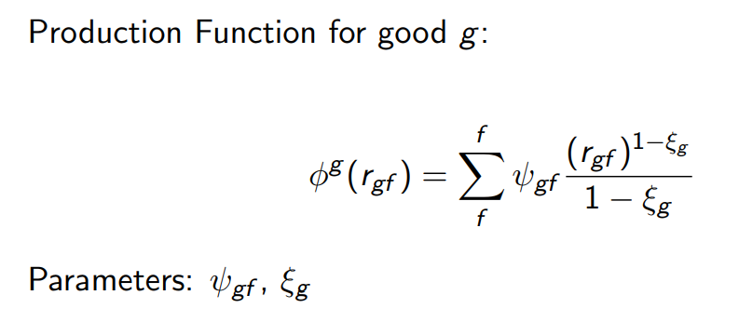
Our production function
Psi: the technology or efficiency of the product
Xi: elasticity of the product

Slide 3
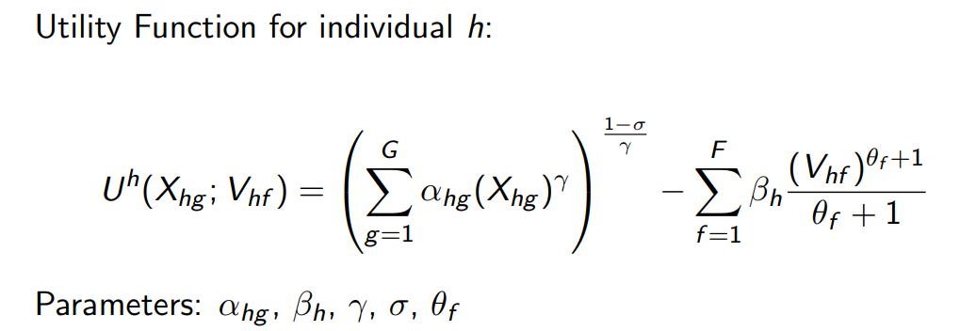
Our utility function
Alpha: the weight of utility
Beta: the weight of disutility

Slide 4
Our utility function
Gamma: the elasticity of consumption
Sigma: the elasticity of substitution between goods

Slide 5
Our utility function
Theta: the elasticity of factors

Slide 6
Thank you!

